Slide 1
School of Geography and Geology
McMaster University
Introduction to Spatial Statistics
(510-654)
PART IV (2):
Area Data

Slide 2
This session:
Part V: Area Data
  Visualization of area data
  Exploring area data
  First order properties
    Spatial proximity matrices
    Moving averages
    Kernel estimation

Slide 3
This session:
Part V: Area Data
  Second Order Properties
    Spatial correlation
      Moran’s I
      Geary’s c
      Correlogram
    Local spatial association
      Local Moran’s I
      Moran’s scatterplot
      Getis and Ord G_{i}(d) statistic

Slide 4
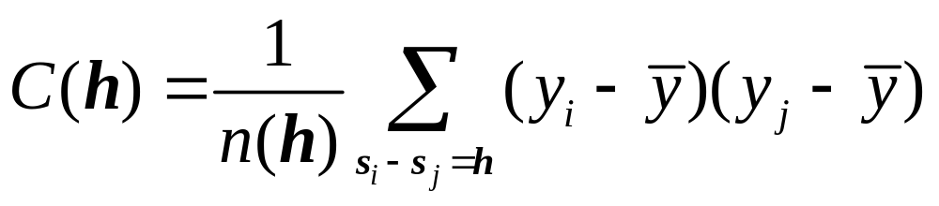
Covariogram
A plot of the covariance of the process at various spatial lags

Slide 5
Covariogram
C(0)=σ²
h

Slide 6
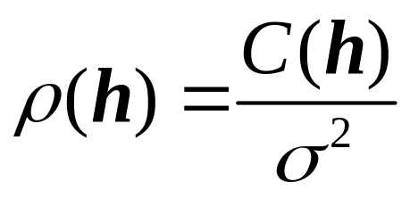
Correlogram
ρ(0)=1
h

Slide 7
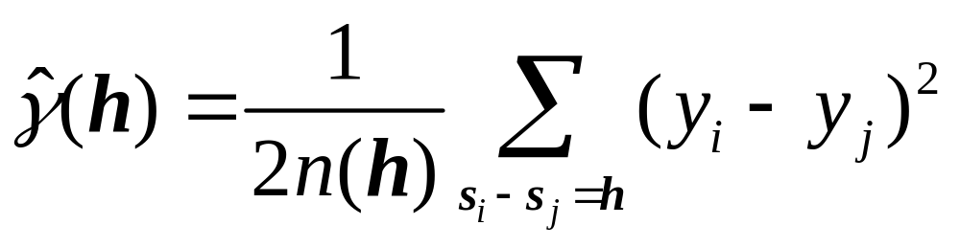

Variogram
σ²
Sill
Range
h

Slide 8
Spatial dependency
Do attributes in “neighboring” zones show spatial dependency? i.e. Do they co-vary?

Slide 9
Spatial Correlation
A₂
A₁
A₃
A₆
A₄
A₅

Slide 10
Proximity Matrix
A₁
A₂
A₃
A₄
A₅
A₆
0 | 1 | 0 | 0 | 0 | 1
1 | 0 | 1 | 0 | 0 | 0
0 | 1 | 0 | 1 | 0 | 0
0 | 0 | 1 | 0 | 1 | 0
0 | 0 | 0 | 1 | 0 | 1
1 | 0 | 0 | 0 | 1 | 0
A₁
A₂
A₃
A₄
A₅
A₆

Slide 11
Spatial Correlation
4
5
A₂
3
A₁
A₃
A₆
A₄
4
A₅
2
3

Slide 12
Spatial Correlation
1
5
A₂
5
A₁
A₃
A₆
A₄
1
A₅
1
5

Slide 13
Spatial Correlation
7
10
A₂
4
A₁
A₃
A₆
A₄
7
A₅
1
4

Slide 14
Spatial Correlation
4
5
A₂
5
A₁
A₃
A₆
A₄
4
A₅
4
5

Slide 15
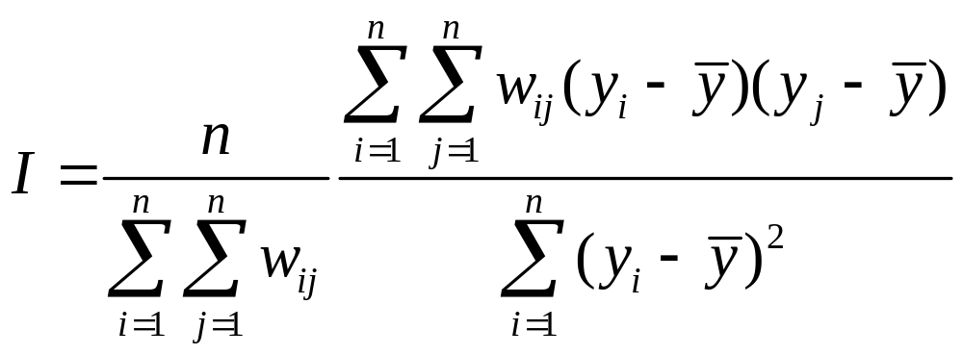
Spatial Correlation
Moran’s I

Slide 16
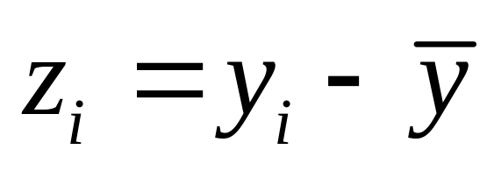
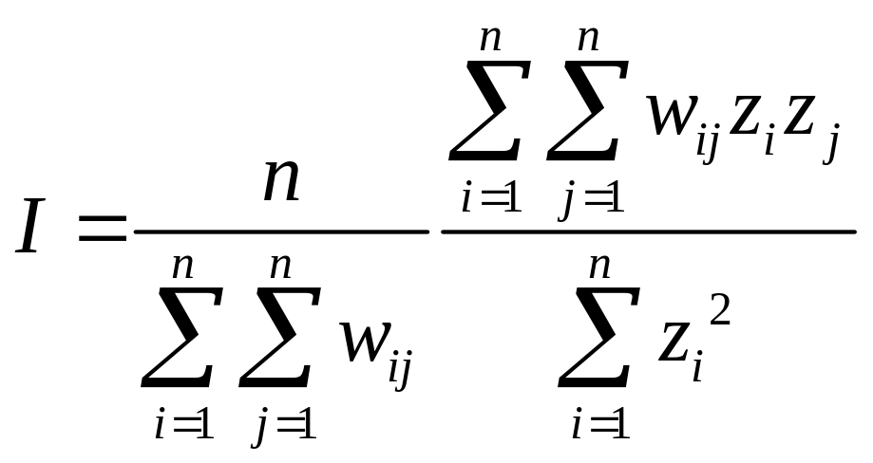
Spatial Correlation
Moran’s I
*Row standardization?

Slide 17
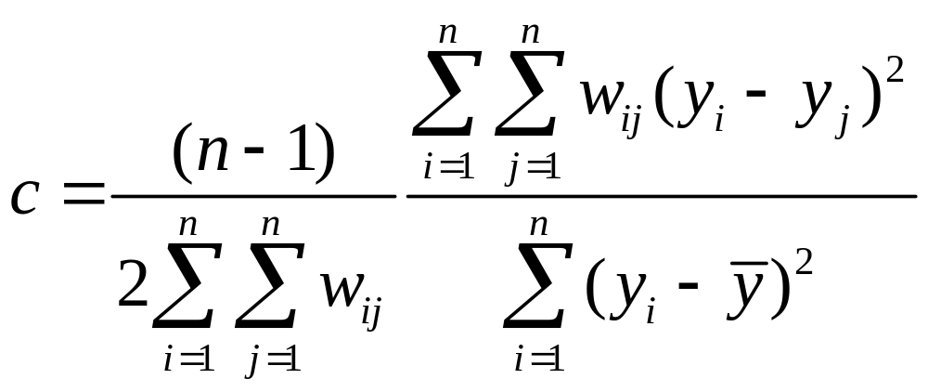
Spatial Correlation
Geary’s c

Slide 18
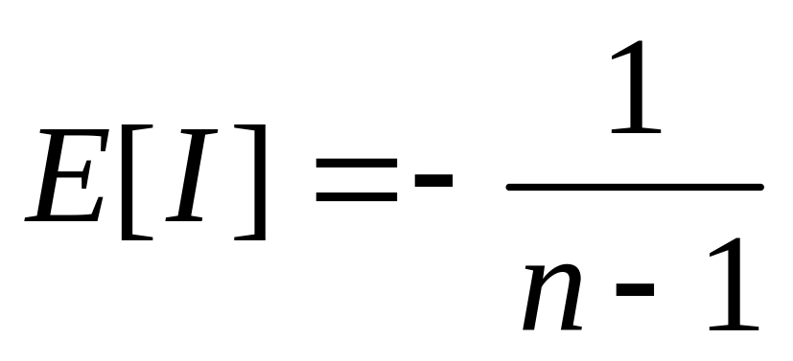
Moran’s I
Expected value (mean)
* Testing for significance

Slide 19
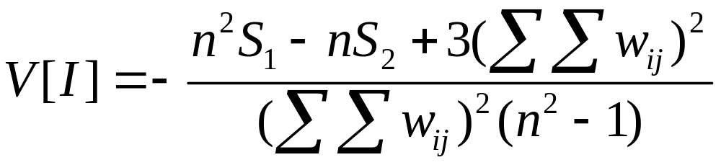
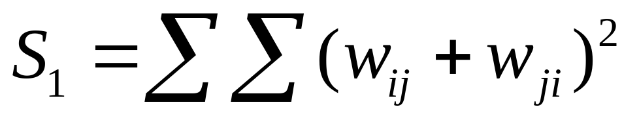
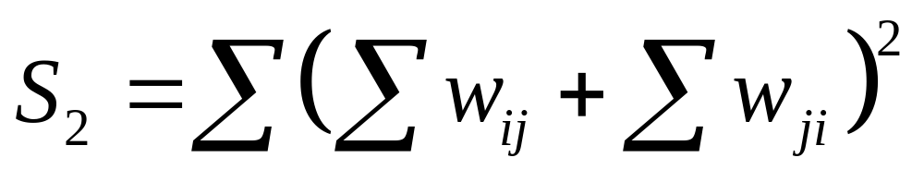
Moran’s I
Variance

Slide 20
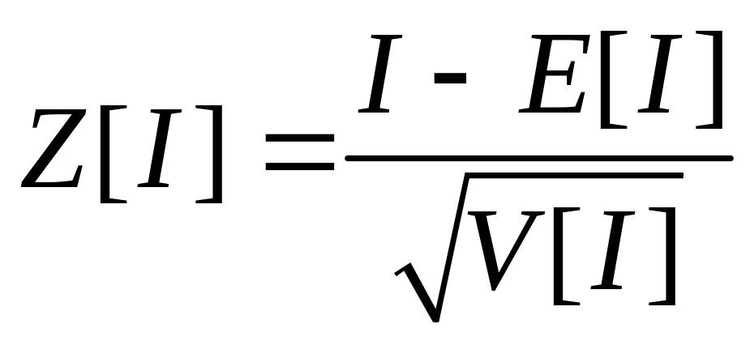
Moran’s I
Testing for significance
  Asymptotically normally distributed
* Testing for significance

Slide 21
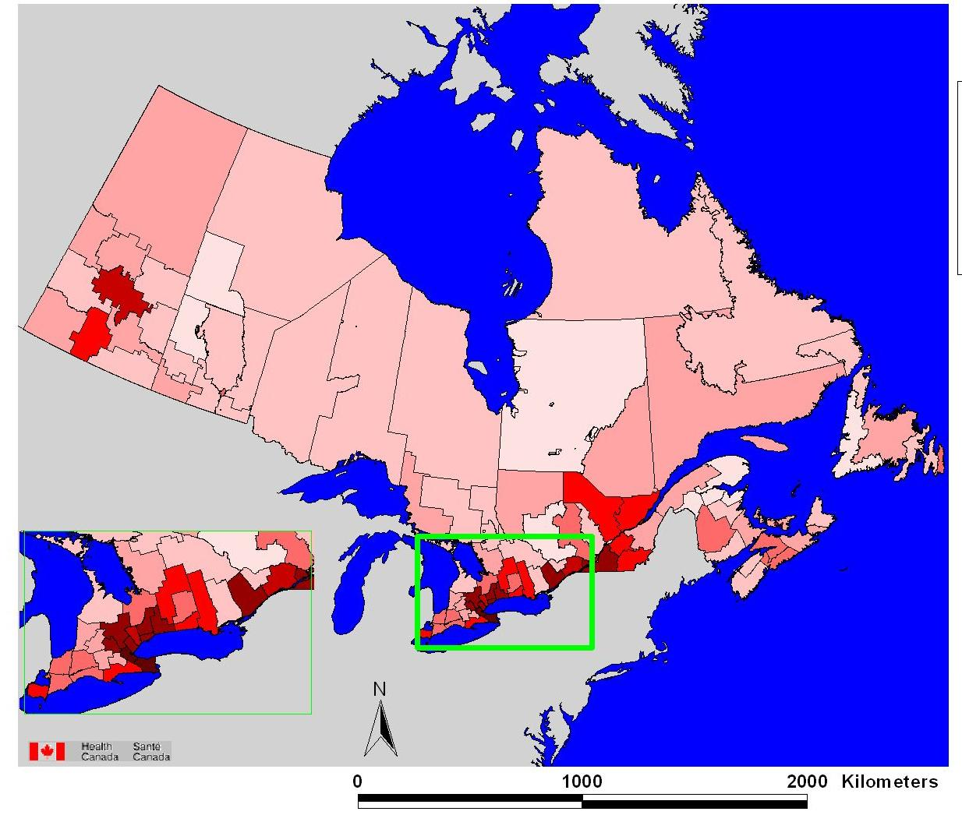
Applications: Map patterns
Number of dead birds reported (2000)

Slide 22
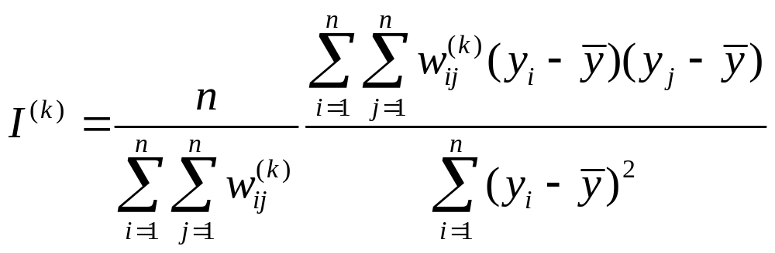
Higher Order Neighbors
Moran’s I using higher order neighbors

Slide 23
Correlogram
A graph showing the value of Moran’s I at different distances

Slide 24
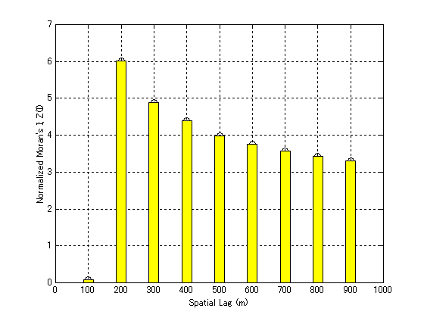
Correlogram:
Land Prices in Sendai

Slide 25
Example: Spatial-Temporal Spread of AIDS in Florida (1982-1990)
8
8
8
6
1982
6
1983
6
1984
4
4
4
2
2
2
0
0
0
-2
-2
-2
-4
-4
-4
-6
1 2 3 4 5 6 7 8
-6
1 2 3 4 5 6 7 8
-6
1 2 3 4 5 6 7 8
8
8
8
6
1985
6
1986
6
1987
4
4
4
2
2
2
0
0
0
Source: N. Lam, M. Fan and K. Liu (1996)
-2
-2
-2
-4
-4
-4
-6
1 2 3 4 5 6 7 8
-6
1 2 3 4 5 6 7 8
-6
1 2 3 4 5 6 7 8
8
8
8
6
1988
6
1989
6
1990
4
4
4
2
2
2
0
0
0
-2
-2
-2
-4
-4
-4
-6
1 2 3 4 5 6 7 8
-6
1 2 3 4 5 6 7 8
-6
1 2 3 4 5 6 7 8

Slide 26
Global Statistics
Global patterns
1 statistic for all the study area
What is happening at specific locations?

Slide 27
Global Statistics

Slide 28
Local Statistics
Local Indicators of Spatial Association (LISA)
Getis and Ord G_{i}(d) statistic

Slide 29
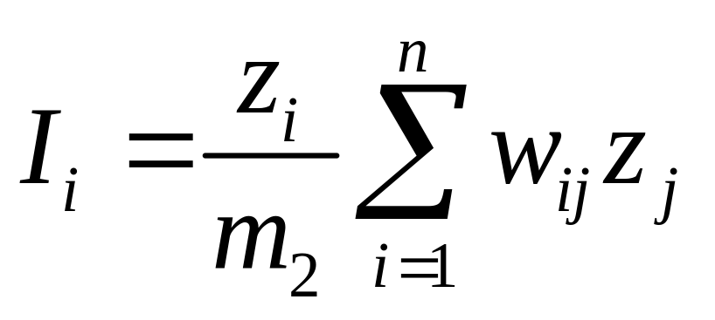
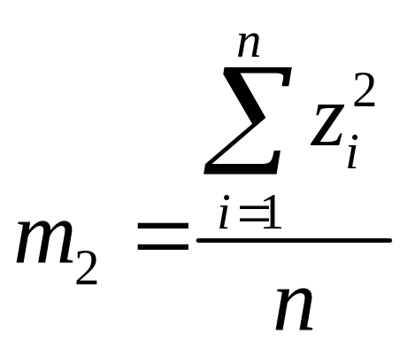
LISA
Decomposition of Moran’s I
*Patterns of association

Slide 30
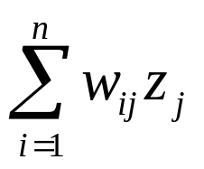
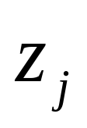
Moran’s Scatterplot
L-H
H-H
L-L
H-L

Slide 31
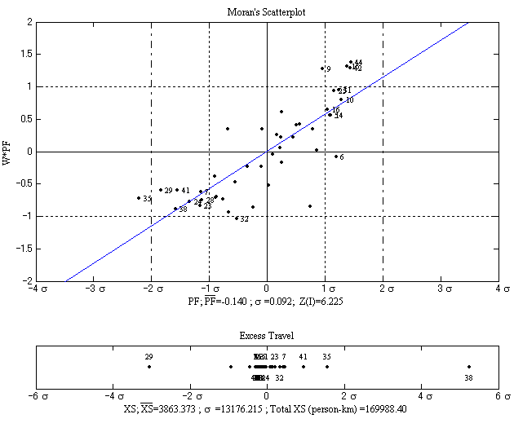
Moran’s Scatterplot:
Commuting Patterns in Sydney

Slide 32
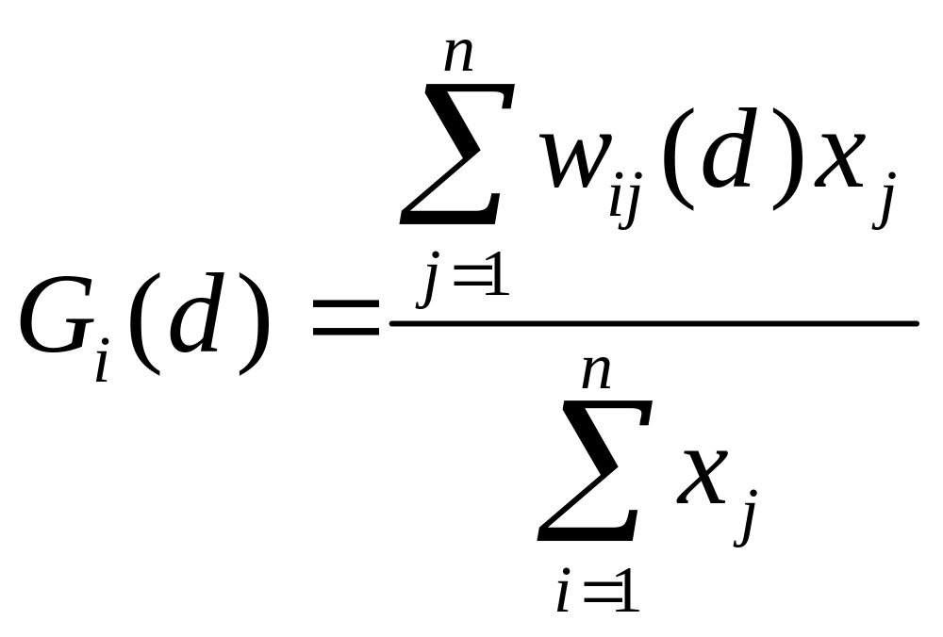
Getis and Ord G_{i}(d) statistic
Indication of the concentration or lack of concentration of a variable

Slide 33
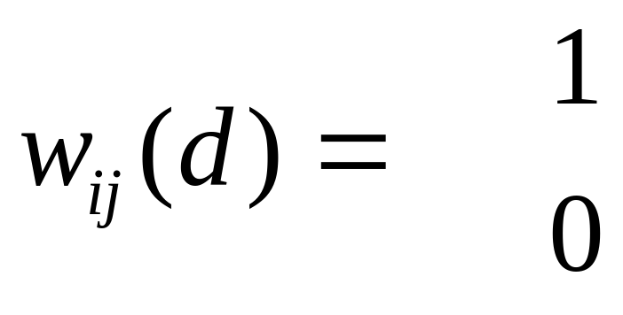
Getis and Ord G_{i}(d) statistic
Binary proximity matrix
if d_{ij} < d
otherwise

Slide 34
Getis and Ord G_{i}(d) statistic

Slide 35
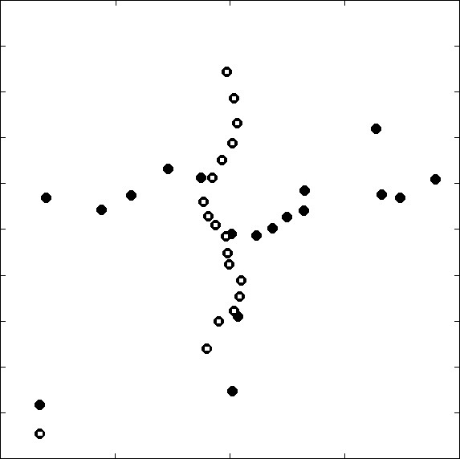
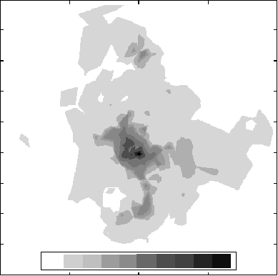
Getis and Ord G_{i}(d) statistic
Subway and Train Stations
20
18
16
14
12
10
8
6
4
2
Izumi
Iwakiri
Kita Sendai
Northing (km)
Ochiai
Northing (km)
Sendai
Nagamachi
Train Station
Minami Sendai
0 100 200 300 400 500 1000 2000 3000 4000 5000
Subway Station
0 5 10 15 20
0 5 10 15 20
Easting (km)
Easting (km)
Fig. 1 a) Subway and train stations in Sendai City; b) Land price profiles (unit: \10 000/m²)

Slide 36
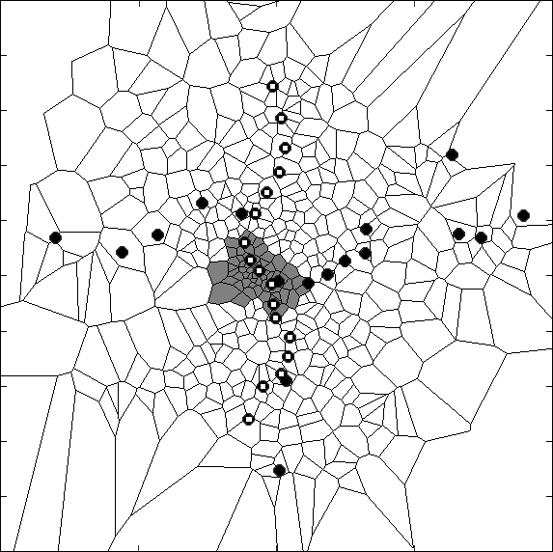
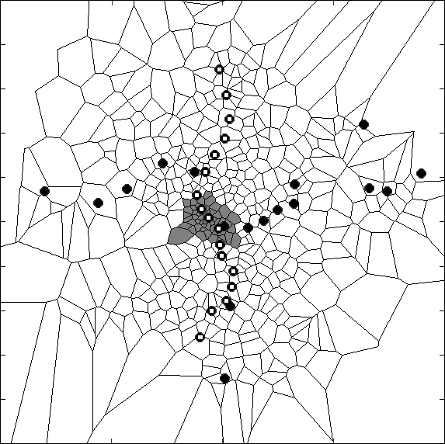
Getis and Ord G_{i}(d) statistic
Case 1) Significance Test
α = 0.05
(Without Correction)
Case 2) Significance Test
α = 0.0001
(With Correction)
Izumi Station
Izumi Station
Sendai Station
Sendai Station
Nagamachi Station
Nagamachi Station
Scale 5km
Scale 5km
Z(G
i
) Significant Observation (+)
Z(G
i
) Non-significant Observation
Fig. 2 Local autocorrelation analysis: a) Without Bonferroni correction; b) With Bonferroni correction

Slide 37
The End

